Slide 1
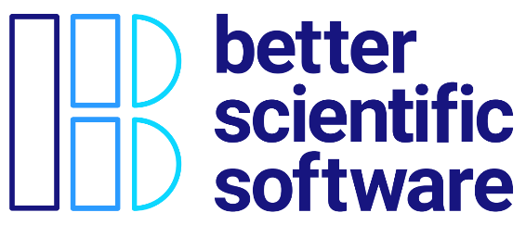
Improving Reproducibility Through Better Software Practices
David E. Bernholdt, David Rogers Oak Ridge National Laboratory
Michael A. Heroux Sandia National Laboratories
Better Scientific Software Tutorial RF SciDAC 2020 Workshop
See slide 2 for license details

Slide 2
License, Citation and Acknowledgements
License and Citation
This work is licensed under a Creative Commons Attribution 4.0 International License (CC BY 4.0).
The requested citation the overall tutorial is: David E. Bernholdt, Better Scientific Software tutorial, in RF SciDAC 2020 Workshop, Knoxville, Tennessee. DOI: 10.6084/m9.figshare.11918397
Individual modules may be cited as Speaker, Module Title, in Better Scientific Software Tutorial…
Acknowledgements
Additional contributors to this this tutorial include: Anshu Dubey, Mike Heroux, Alicia Klinvex, Jared O’Neal, and Katherine Riley, James M. Willenbring
This work was supported by the U.S. Department of Energy Office of Science, Office of Advanced Scientific Computing Research (ASCR), and by the Exascale Computing Project (17-SC-20-SC), a collaborative effort of the U.S. Department of Energy Office of Science and the National Nuclear Security Administration.
This work was performed in part at the Argonne National Laboratory, which is managed managed by UChicago Argonne, LLC for the U.S. Department of Energy under Contract No. DE-AC02-06CH11357.
This work was performed in part at the Oak Ridge National Laboratory, which is managed by UT-Battelle, LLC for the U.S. Department of Energy under Contract No. DE-AC05-00OR22725.
This work was performed in part at Sandia National Laboratories. Sandia National Laboratories is a multi-mission laboratory managed and operated by National Technology and Engineering Solutions of Sandia, LLC., a wholly owned subsidiary of Honeywell International, Inc., for the U.S. Department of Energy’s National Nuclear Security Administration under contract DE-NA0003525. SAND NO SAND2017-5474 PE

Slide 3
Terminology
A few of the terms used when talking about this topic…
Reproducibility
Replicability
Reliability
Correctness
Accuracy
Transparency
Credibility
They don’t mean exactly the same thing…
…but for the purposes of this presentation, the differences don’t really matter

Slide 4
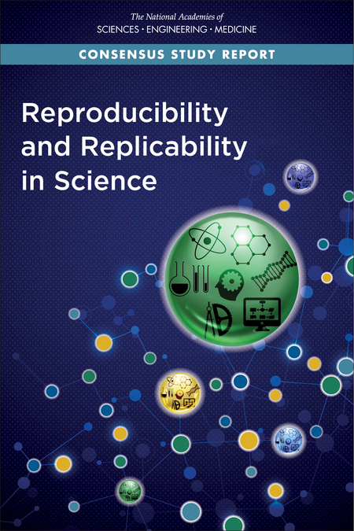
Reproducible vs Replicable: A Special Note
Historically different communities have defined these two differently
With the increased focus, there has also been an effort to unify the language
Consensus around the definitions of Claerbout, et al.
Others are in the process of switching their terminology to match, i.e., ACM
Reproducible: Another team is able to obtain the same result using the authors’ experimental environment
Replicable: Another team is able to obtain consistent results using a different experimental environment
https://cfwebprod.sandia.gov/cfdocs/CompResearch/docs/SAND2018-11186.pdf
https://www.nap.edu/catalog/25303/reproducibility-and-replicability-in-science

Slide 5
Why Reproducibility is Important

Slide 6
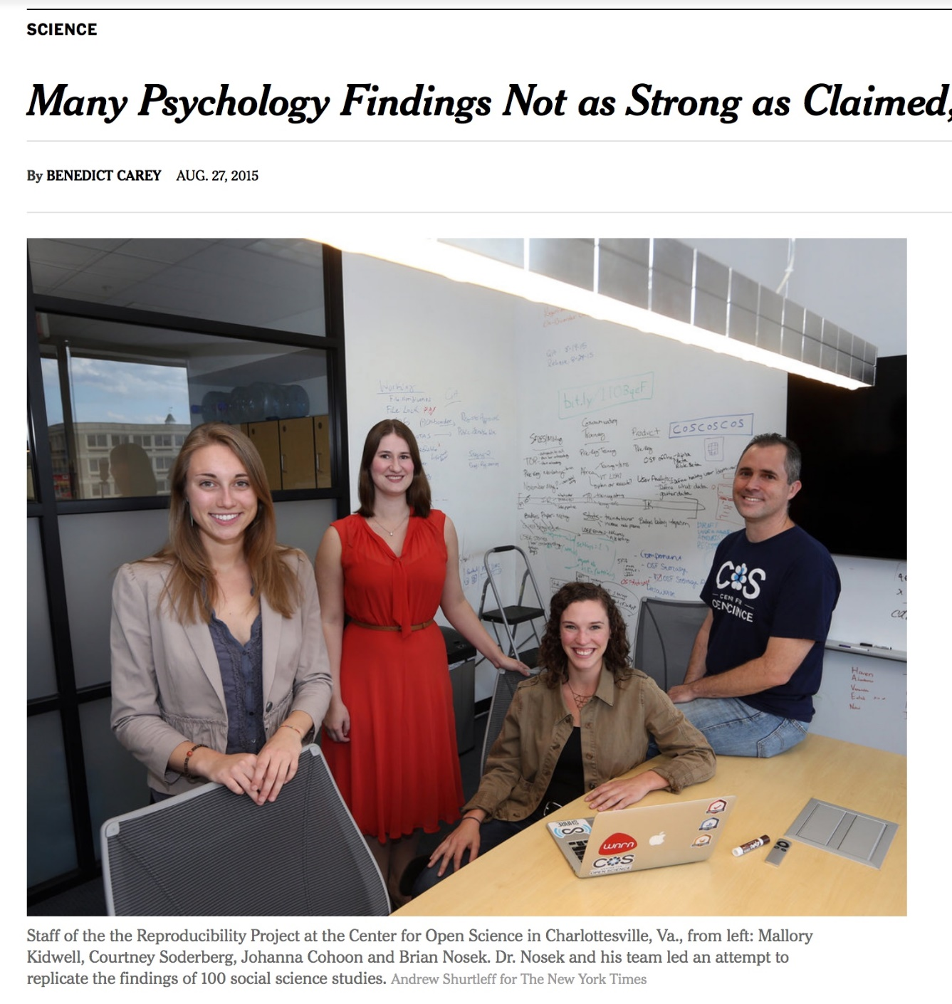
Transparency & Reproducibility
NY Times highlights “problems”.
Only one of many cited examples.
Computational science had been spared this “spotlight”.
http://www.nytimes.com/2015/08/28/science/many-social-science-findings-not-as-strong-as-claimed-study-says.html

Slide 7
Computational Science Example
Behavior of pure water just above homogeneous nucleation temperature (~ - 40 C/F).
Debenedetti/Princeton (2009):
2 possible phases: High or low density.
Chandler/Berkeley (2011):
Only 1 phase: High density.
No sharing of details across teams until 2016:
Chandler in Nature: “LAMMPS codes used in refs 5 and 12 are standard and documented, with scripts freely available upon request.”
Debenedetti with colleague Palmer: ”Send us your code.”
Received code after requests and appeal to Nature.
Source: https://physicstoday.scitation.org/do/10.1063/PT.6.1.20180822a/full/

Slide 8
Computational Science Example
Palmer located bug/feature in Berkeley code.
Used to speed up LAMMPS execution.
Replaced with more standard approach.
Obtained result similar to Debenedetti 2009.
Resolution took 7 years.
Source: https://physicstoday.scitation.org/do/10.1063/PT.6.1.20180822a/full/
For Palmer, the ordeal exemplifies the importance of transparency in scientific research, an issue that has recently drawn heightened attention in the science community. “One of the real travesties,” he says, is that “there’s no way you could have reproduced [the Berkeley team’s] algorithm—the way they had implemented their code—from reading their paper.” Presumably, he adds, “if this had been disclosed, this saga might not have gone on for seven years.”

Slide 9
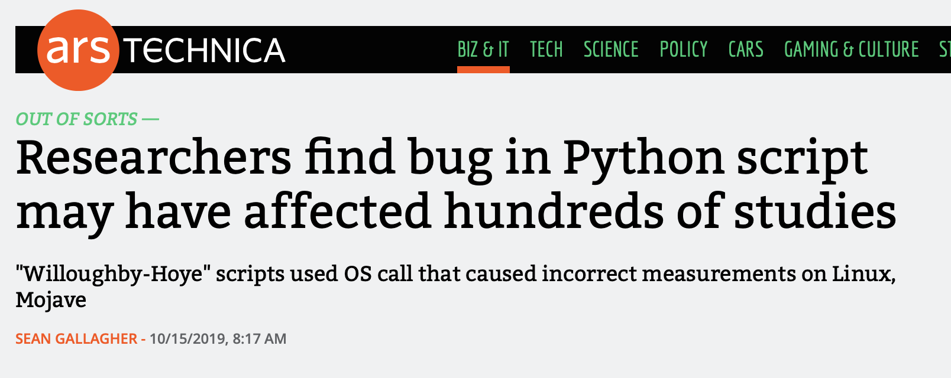
A Recent Example: Python Behaves Differently on Different Platforms
Scripts' use of Python's glob module
Generated different file lists in Linux and Mac Mojave
Casts doubt on results in 150 papers.
Would a unit test have caught this?
https://arstechnica.com/information-technology/2019/10/chemists-discover-cross-platform-python-scripts-not-so-cross-platform/

Slide 10
Research Software Used in Policymaking gets Scrutiny
Mar. 16: Neil Ferguson (Imperial College) briefed UK Parliament on epidemiological modeling of COVID-19 pandemic
Epidemiological models like this helped prompt government action, but have lots of assumptions
April 1: Nicholas Lewis (independent climate science researcher in UK) can’t easily see where some of the assumptions come from – publishes a blog article
April 22: Imperial collaborates with Microsoft to refactor and clean up the code, which is released on GitHub
May 16: Daily Telegraph and Fox News sensationalize the story
“In our commercial reality, we would fire anyone for developing code like this and any business that relied on it to produce software for sale would likely go bust,” David Richards, co-founder of British data technology company WANdisco
May 29: CODECHECK independently reproduces paper reporting Imperial’s results
Documentation and test cases become more critical as the code’s results became more relevant!
https://www.nature.com/articles/d41586-020-01003-6
https://www.nicholaslewis.org/imperial-college-uk-covid-19-numbers-dont-seem-to-add-up/
https://www.foxnews.com/world/imperial-college-britain-coronavirus-lockdown-buggy-mess-unreliable
https://github.com/mrc-ide/covid-sim/issues/116 ‘’There appears to be a bug in either the creation or re-use of the network file’’
https://philbull.wordpress.com/2020/05/10/why-you-can-ignore-reviews-of-scientific-code-by-commercial-software-developers/amp/
http://doi.org/10.5281/zenodo.3865491

Slide 11
Science through computing is, at best, as credible as the software that produces it!

Slide 12
(Additional) Incentives for Paying Attention to Reproducibility

Slide 13

Reproducibility and Supercomputing
Supercomputer cycles are scarce resources
No one wants to spend their precious allocation running simulations two or three times to be confident of the results
Though this ends up happening more than most people admit
And it could still be wrong!
But lots of people need to have confidence in your results
You
Your project lead or boss
Your sponsor
Your reviewers or referees
Your readers
Need to think about how to build credibility without repeating runs

Slide 14
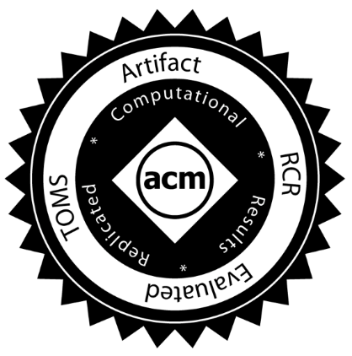
ACM TOMS Reproducible Computational Results (RCR)
Submission: Optional RCR option.
Standard reviewer assignment: Nothing changes.
RCR reviewer assignment:
Concurrent with standard reviews.
As early as possible in review process.
Known to and works with authors during the RCR process.
RCR process:
Multi-faceted approach, Bottom line: Trust the reviewer.
Publication:
Reproducible Computational Results Designation.
The RCR referee acknowledged.
Review report appears with published manuscript.

Slide 15
SC20 Transparency and Reproducibility Initiative
Two appendices:
Artifact description (AD).
Blue print for setting up your computational experiment.
Makes it easier to rerun computations in future.
AD appendix is mandatory for paper submissions (since SC19).
Largely auto-generated from submission information.
Artifact Evaluation (AE).
Targets “boutique” environments.
Improves trustworthiness when re-running hard, impossible.
Remains optional
Details:
https://sc20.supercomputing.org/submit/transparency-reproducibility-initiative/

Slide 16
Coming to Your World Soon: Reproducibility Requirements
These conferences have artifact evaluation appendices:
CGO, PPoPP, PACT, RTSS and SC.
http://fursin.net/reproducibility.html
ACM Replicated Reproducible Computational Results (RCR).
ACM TOMS, TOMACS.
http://toms.acm.org/replicated-computational-results.cfm
ACM Badging.
https://www.acm.org/publications/policies/artifact-review-badging
NISO Committee on Reproducibility and Badging.
https://www.niso.org/niso-io/2019/01/new-niso-project-badging-scheme-reproducibility-computational-and-computing
Publishers: ACM, IEEE, figshare, STM, Reed Elsevier, Springer Nature

Slide 17
Incentives Demand Investments, Enabled by Investments
Demand
Transparency & Reproducibility Requirements
Productivity & Sustainability Investments
Enable
Common statement: “I would love to do a better job on my software, but I need to:
Get this paper submitted.
Complete this project task.
Do something my employer values more.
Goal: Change incentives to include value of better software, better science.

Slide 18
How to Improve Reproducibility

Slide 19
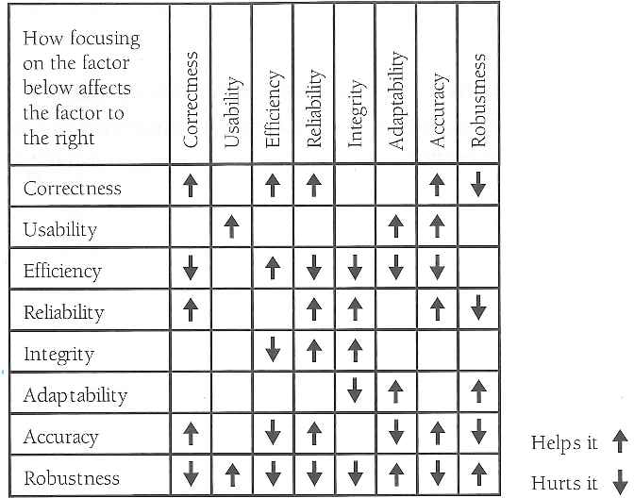
Strategies that Don’t Improve Reproducibility
•
•
•
•
Trusting the code of inexperienced coders
Letting deadlines rule
I don’t have enough time to {test, document, …} the {code, results, …} because I have to finish this {paper, talk, proposal, …}.
Code performance optimization
Utilizing dynamic parallelism (standard on modern processors)
Different code for different hardware
Ignoring the possibility of silent data corruption
from Code Complete by Steve McConnell

Slide 20
Strategies for Improving Reproducibility During Development (1/3)
Solid versioning practices are fundamental reproducibility
Version control of code, documentation, and other artifacts
Frequent commits (perhaps to a separate development branch)
Provide versioning information in key output(s)
Version numbers (i.e., semantic versioning) are useful, but when do you increment them?
Automatic identifiers (i.e., git commit hash) are less ambiguous, but may not be as meaningful
Is the code you’re building modified from the version in the repository?
Not often done in practice
Maintaining documentation (and other artifacts) in sync with code
You’ll forget
Or you won’t have (make) time to go back to it

Slide 21
Strategies for Improving Reproducibility During Development (2/3)
Build in quality from the start
Define and follow coding standards
Not just code style
Expectations for kinds and extent of documentation, types and rigor of tests
Develop tests as you code
Write tests while the code is fresh in your mind
Test Driven Development (TDD) means write tests before code, then code to pass the tests
Require increasingly rigorous testing as the code becomes more “public”
Testing has costs, need to balance level of risk against cost of executing tests
Also think about frequency of tests at different levels of cost (c.f. continuous integration)
Practice peer code review
Retrospective if you have a lot of existing unreviewed code
Per commit – should meet standards, and be understood and judged correct by reviewer
Pair experienced reviewers with less experienced coders to help ensure quality

Slide 22
Strategies for Improving Reproducibility During Development (3/3)
Be judicious in pursuit of performance
Start with straightforward, portable implementations
They are more easily understood by future developers
“Tricky” or more complicated code is more likely to have undetected bugs
Focus optimization efforts on actual bottlenecks
If your algorithm is N³, accelerating an N² operation probably won’t make much difference
If you’re creating hardware-specific versions, make sure you’re testing on each platform
Treat optimization like a refactoring exercise
Make sure it is covered by tests
Examine both correctness and performance gains
Include options to eliminate non-determinism
Usually has a performance cost, but may improve testability/debugability

Slide 23
Strategies for Improving Reproducibility After Development
Testing, testing, and more testing!
Add more tests
Be creative
Think about corner cases
Think about misuse (unintentional or intentional)
Think about synthetic tests with synthetic data
Think about low-cost tests that can be “always on” (even if they’re not so stringent)
Can you detect silent data corruption?
Test your tests!
Make sure tests fail when they’re supposed to!
Thoroughly verify the code
Does the code do what you intended it to do?
On all relevant platforms

Slide 24
Digression – “Physics” (or Math)-Based Testing Strategies
Use what you know (or can construct) about the model you’re studying to test its implementation
Synthetic operators with known properties
Spectrum (huge diagonals)
Rank (by construction)
Invariance principles
Translational, rotational, etc.
Physical symmetries
Mathematical symmetries
Conservation rules
Fluxes, energy, mass, etc.
…

Slide 25
Digression – Design by Contract Programming
Building testing into your routines
To complement, not replace, other testing
The interface to a routine can be thought of as a contract between caller and the routine
What does the contract expect? preconditions
What does the contract guarantee? postconditions
What does the contract maintain? invariants
Given valid inputs (preconditions satisfied) a routine should guarantee valid outputs (postconditions satisfied, invariants maintained)
If the preconditions are not satisfied, the routine should return an error
Making the contract explicit facilitates correct use of routines
Especially when routine is reused in another context
Especially by those not intimately familiar with them

Slide 26
Strategies for Improving Reproducibility During Experiments (1/3)
What are you going to do, why, and how?
Plan your experiments thoroughly
Know what you need (in the code, as inputs, as outputs to capture/analyze, etc.)
Know how you’re going to process or analyze the results
Know what to expect (in results, performance/cost, etc.)
How will you convince yourself that your results are trustworthy?
Perform pilot/test runs to build confidence in correctness, performance, scaling
Often useful to pursue an incremental/layered strategy
Ensure that you have the resources to store and/or analyze the outputs
What can you afford to archive?
What will you need to process and delete?
What will you need to process during execution or stream?

Slide 27
Strategies for Improving Reproducibility During Experiments (2/3)
Can you reproduce the code used for each and every experiment?
Three years later?
Use only well-defined versions of code (i.e., official “releases”, tags, etc.)
Master or development branches are often moving targets
Capture the exact version of the code used for each experiment
Is the code you’re building exactly what’s in the version control repo?
Don’t change versions during a related series of experiments (unless you have to)
If you have to change versions, know exactly what changed
Capture the exact version of the code used for each experiment
Use only versions of code that have been thoroughly verified
Consider capturing version information of key libraries, compilers, and other dependencies used to build code
Not often done, in practice

Slide 28
Strategies for Improving Reproducibility During Experiments (3/3)
Be thorough in capturing provenance
Agents (codes), entities (inputs, outputs, etc.), activities (the transformation)
Capture code version
Capture all inputs/configuration information for each experiment
Use multiple systems to ensure that you can correctly associate inputs, outputs, and code versions
Systematic directory and file naming conventions
Separate written notes (paper notebook, electronic notebook)
Scripts to orchestrate experiments (versioned and captured)
Version control (if data is not too large)
Capture important outputs (as feasible)

Slide 29
Strategies for Improving Reproducibility After Experiments
Continue provenance capture through data analysis/reduction process
Agents (codes), entities (inputs, outputs, etc.), activities (the transformation)
Script as much of your analysis/reduction as possible
Prefer scriptable tools over those requiring human interaction
Keep them under version control
Document your process thoroughly
Separately from scripts, etc.
E.g., paper or electronic notebook
Especially where human interaction is required
Capture key intermediates in the reduction process
The more you capture, the more you have to verify (and find problems) later
Capture the data (in machine-readable form) used to produce graphs and tables
Expected by basic data management plans
And an increasing number of publishers

Slide 30
Summary
The credibility of your science derives from the credibility of your code (and process)
Science stakeholders are ratcheting up expectations for reproducibility
There are strategies to improve reproducibility in all phases of the scientific process
During development
After development
During experiments
After experiments
They amount to better software development practices
The same kinds of practices advocated for reasons of productivity, sustainability, maintainability, etc.

Slide 31
Other resources
Editorial: ACM TOMS Replicated Computational Results Initiative. Michael A. Heroux. 2015. ACM Trans. Math. Softw. 41, 3, Article 13 (June 2015), 5 pages. DOI: http://dx.doi.org/10.1145/2743015
Enhancing Reproducibility for Computational Methods. Victoria Stodden, Marcia McNutt, David H. Bailey, Ewa Deelman, Yolanda Gil, Brooks Hanson, Michael A. Heroux, John P.A. Ioannidis, Michela Taufer Science (09 Dec 2016), pp. 1240-1241

Slide 32
Agenda
Time | Module | Topic | Speaker
1:00pm-1:05pm | 00 | Introduction | David E. Bernholdt, ORNL
1:05pm-1:30pm | 01 | Overview of Best Practices in HPC Software Development | David E. Bernholdt, ORNL
1:30pm-2:00pm | 02 | Agile Methodologies and Useful GitHub Tools | David E. Bernholdt, ORNL
2:00pm-2:30pm | 03 | Improving Reproducibility through Better Software Practices | David E. Bernholdt, ORNL
2:30pm-2:45pm |  | Q&A | All
2:45pm-3:30pm |  | Break
3:30pm-4:15pm | 04 | Software Design and Testing | David E. Bernholdt, ORNL
4:14pm-4:45pm | 05 | Continuous Integration | David E. Bernholdt, ORNL
4:45pm-5:00pm |  | Q&A | All

